Slide 1
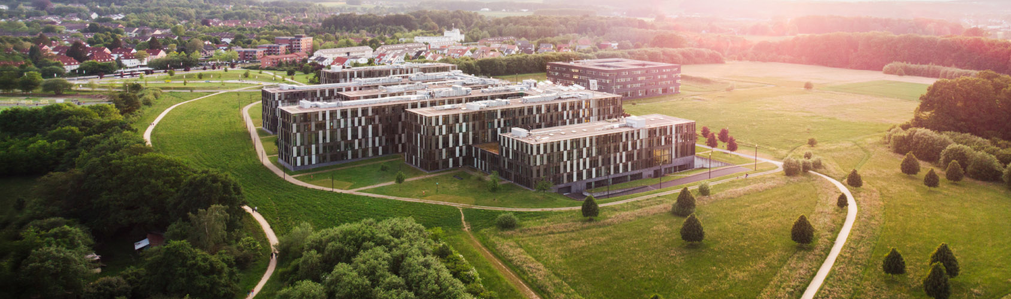
Time-Series Analytics with Caching Layer
Big Data Architectures Project
Jane Kedina Imoke & Ricardo Ramos Morales
Notes:
Good morning, everyone.
Today we will present our project titled Time-Series Analytics with Caching Layer.
The objective of this project was to design and implement a complete Big Data architecture capable of handling continuously generated sensor data, performing historical analytics, accelerating data retrieval through caching, and providing real-time visualization through an interactive dashboard.
The project integrates multiple technologies including InfluxDB, Redis & Spark to create an end-to-end analytics pipeline.

Slide 2
AGENDA
Motivation
Problem Statement
Project Objectives
Architecture Design
Technology Section
System Implementation
Analytics & Anomaly Detection
Dashboard Demonstration
System Evaluation
Challenges & Lessons Learned
Future Enhancements
Conclusions
Notes:
Before diving into the technical details, I'd like to briefly outline the structure of today's presentation.
We will begin by discussing the motivation behind time-series analytics and the problem we set out to solve.
Next, we will define the project objectives and introduce the architecture that underpins the solution.
We will then examine the technologies selected and explain how the system was implemented, including the integration of InfluxDB, Redis, Apache Spark and Docker.
Following this, we will explore the analytical capabilities of the system, including anomaly detection and dashboard visualisation.
We will then evaluate the system's performance, particularly the impact of the Redis caching layer on query latency.
Finally, we will discuss the challenges encountered during development, outline potential future enhancements, and conclude with the key contributions of the project before opening the floor for questions.

Slide 3
SECTION 1
MOTIVATION & PROBLEM STATEMENT

Slide 4
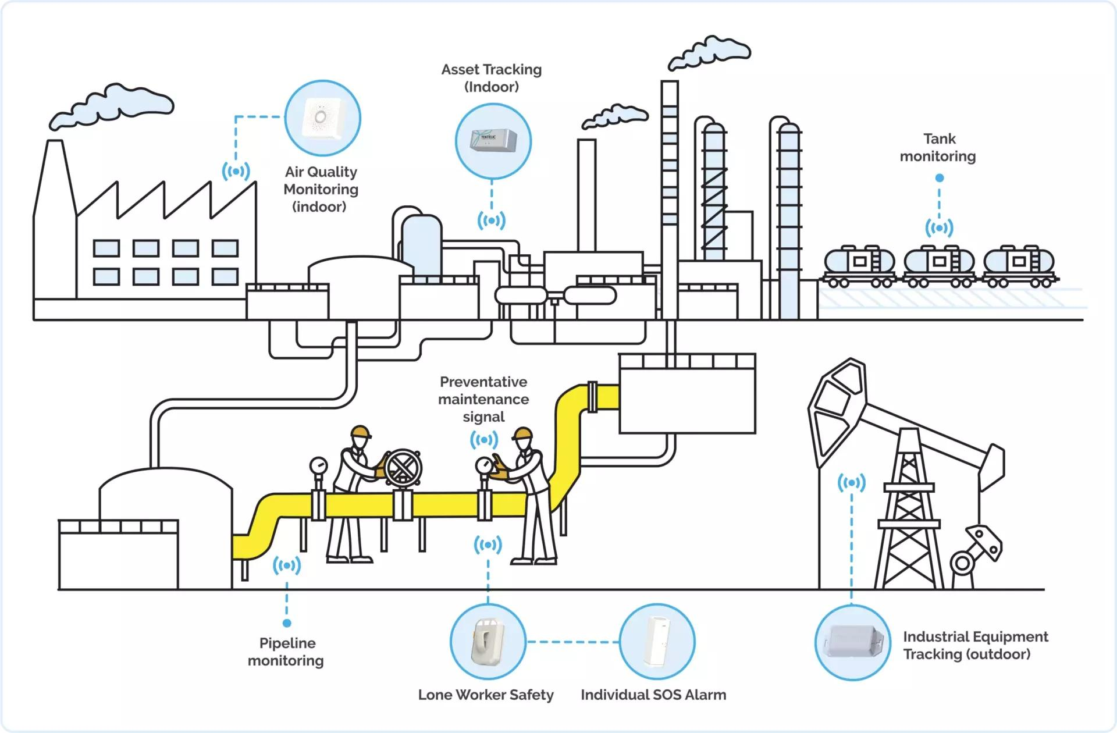
Motivation
Why Time-Series Analytics
Smart factories
Cloud monitoring
Energy systems
IoT devices
Healthcare sensors
Challenges
Continuous data generation
Growing storage requirements
Slow repeated queries
Real-time monitoring needs
Notes:
Modern systems continuously generate timestamped data.
Examples include industrial equipment, cloud servers, energy grids, and IoT devices.
Unlike traditional transactional databases, these systems produce large volumes of sequential data that must be stored efficiently and queried rapidly.
As data volume increases, retrieval performance can degrade significantly.
This creates a need for architectures that support both long-term analytics and low-latency access.

Slide 5
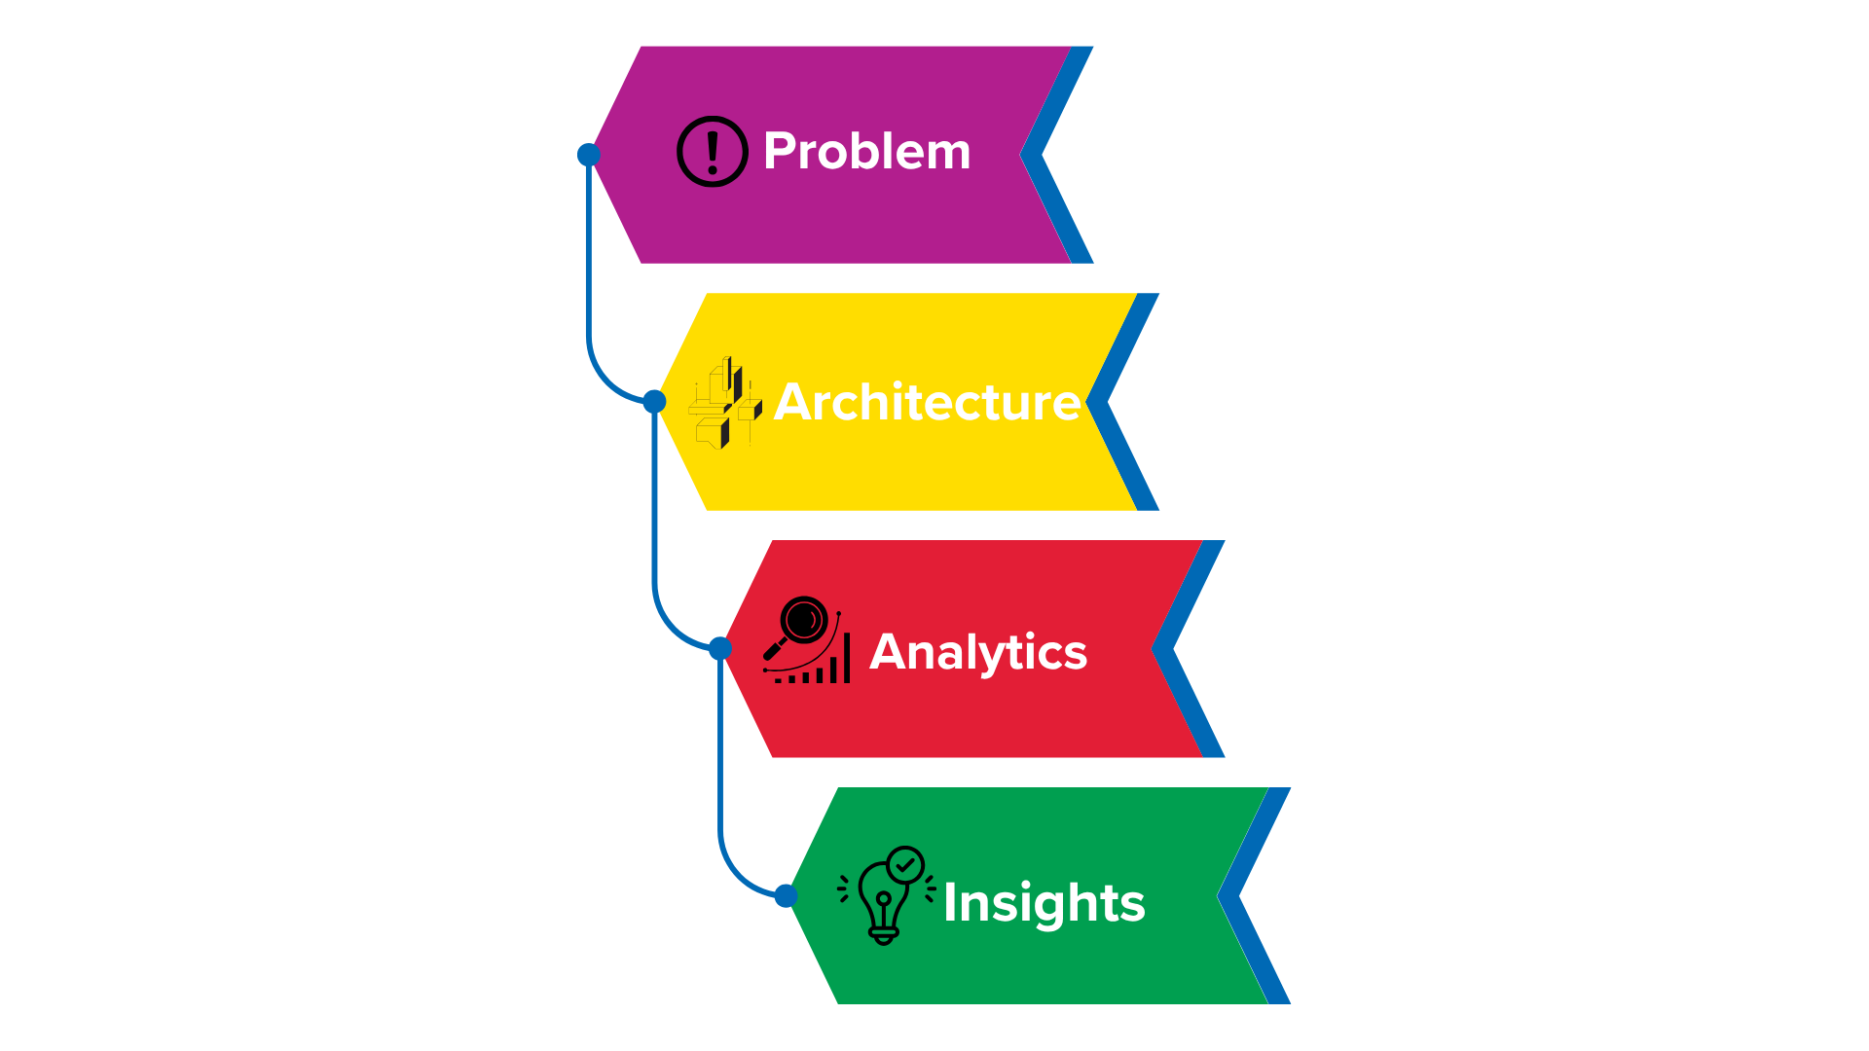
Research problem
How can a Big Data architecture efficiently:
Ingest continuous data
Store historical records
Provide fast retrieval
Detect anomalies
Support real-time monitoring
Notes:
The central challenge addressed in this project is balancing performance and analytical capability.
Organisations need access to historical data for analysis while simultaneously providing users with near real-time information.
Repeated database queries can become expensive and increase latency.
Our project investigates how introducing a caching layer can improve system responsiveness without sacrificing analytical functionality.

Slide 6
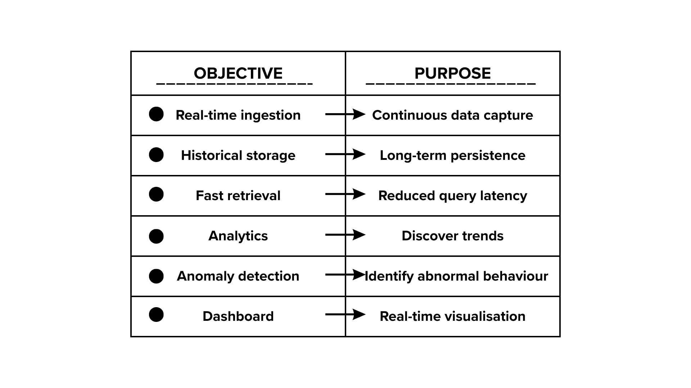
Project objectives
Notes:
These objectives guided the system design.
The architecture needed to support data ingestion, storage, analytics, anomaly detection, and visualization while maintaining performance.
Success was measured through implementation completeness and performance benchmarking.

Slide 7
SECTION 2
ARCHITECTURE DESIGN

Slide 8
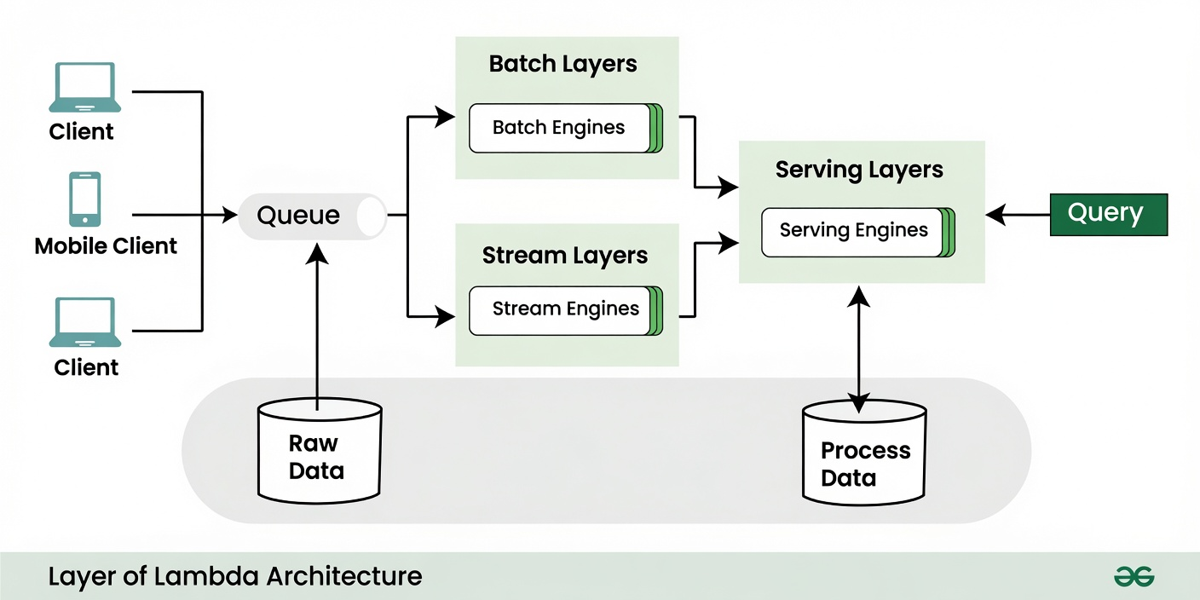
Why lambda architecture
Lambda Architecture:
Batch Layer
Speed Layer
Serving Layer
Benefits:
Scalability
Fault tolerance
Low latency
Historical analysis
Notes:
We adopted a Lambda-inspired architecture because it separates historical processing from real-time access.
The batch layer handles large-scale analytical workloads.
The speed layer provides fast access to recent data.
The serving layer exposes results to users.
This approach is widely used in Big Data systems because it balances analytical depth with responsiveness.

Slide 9
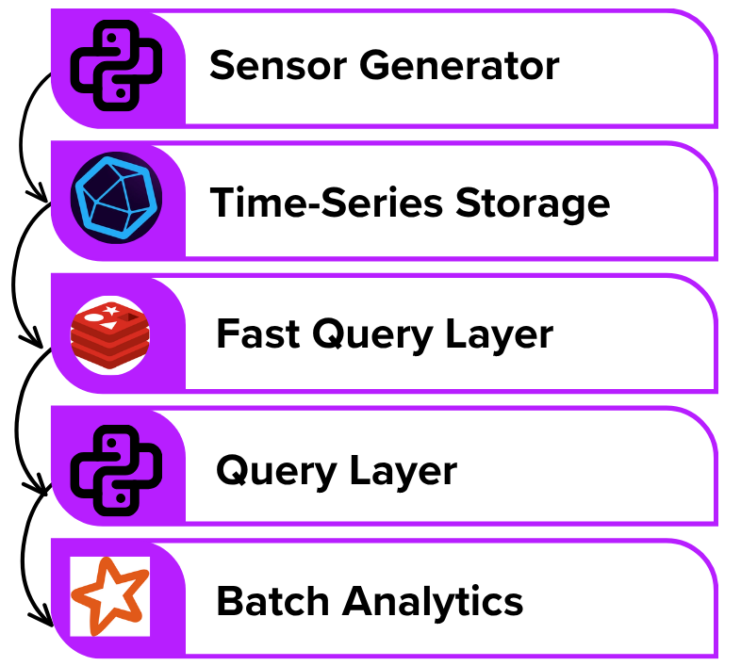
SYSTEM architecture
Components:
Sensor generator
InfluxDB
Redis
Spark
Query Service
Dashboard
Notes:
This diagram illustrates the overall architecture.
A sensor reading first enters InfluxDB.
When a user requests data, Redis is checked first.
If the data is available in Redis, the request is served immediately.
If not, InfluxDB is queried and the result is cached for future requests.
Spark accesses historical data for analytical workloads independently from dashboard requests.

Slide 10
END-to-end data flow
SENSOR GENERATES READINGS
INFLUXDB STORES DATA
DASHBOARD REQUESTS DATA
REDIS CHECKED FIRST
CACHE HIT -> RETURN DATA
CACHE MISS -> QUERY INFLUXDB
STORE IN REDIS
RETURN RESULTS

Slide 11
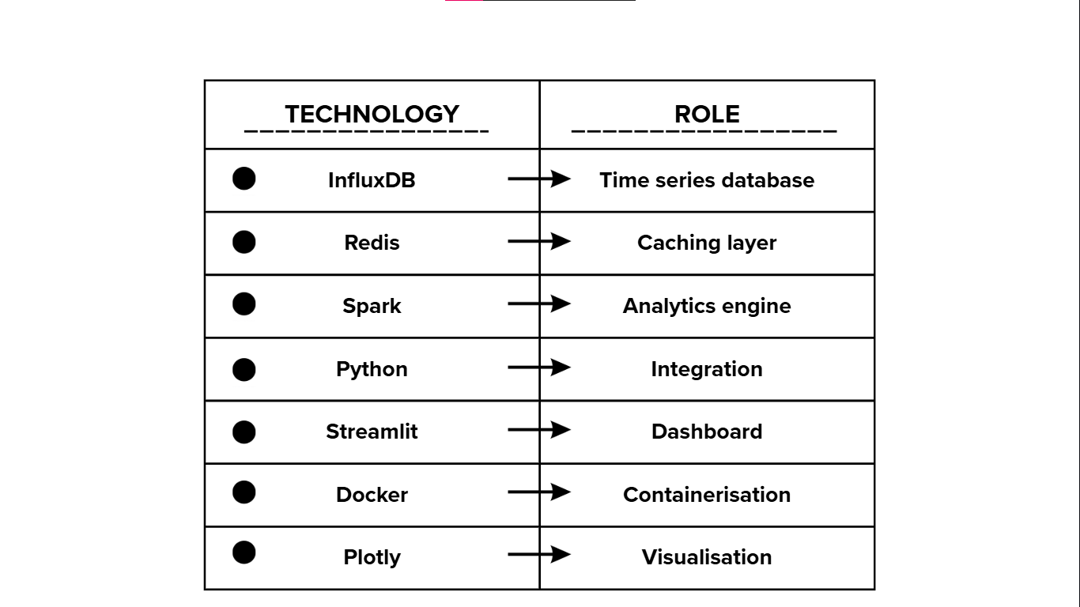
TECHNOLOGY SECTION
Notes:
Each technology was selected because it specialises in a particular function.
InfluxDB was designed specifically for time-series workloads
Redis for extremely low-latency caching
Spark for scalable distributed analytics
Python for APIs & integration
Streamlit for rapid dashboard development
Docker for reproducible deployment
Plotly for data visualisation
Rather than using a single platform for everything, we adopted a polyglot architecture where each component performs the task it was designed for.

Slide 12
SECTION 3
IMPLEMENTATION

Slide 13
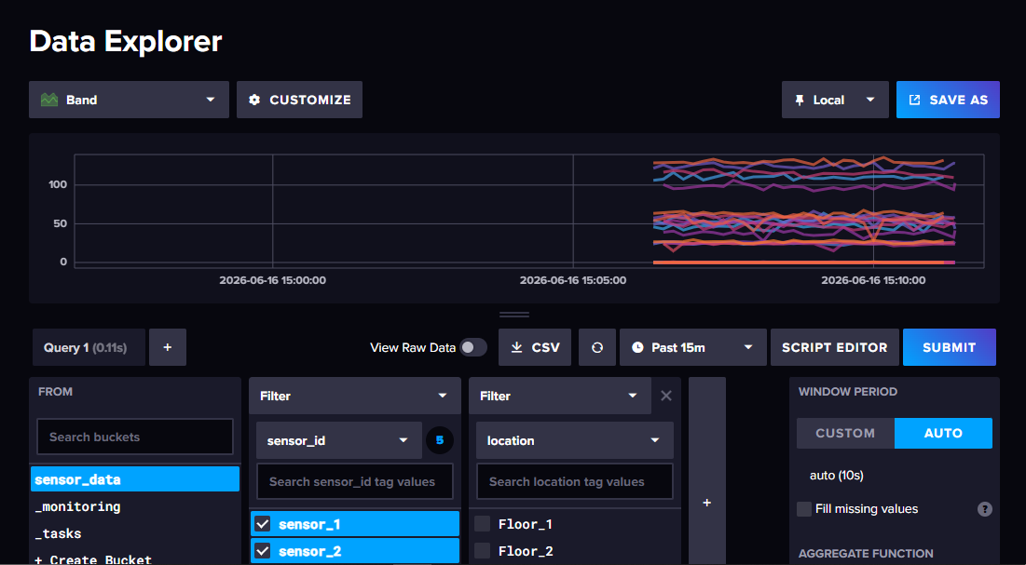
DATA MODEL
sensor_id
location
timestamp
temperature
humidity
cpu_usage
energy_consumption
Status
is_anomaly
anomaly_type
affected_metric
Notes:
Each sensor record contains environmental and system metrics.
The timestamp is critical because it enables time-based analysis and querying.
Additional anomaly indicators support analytical processing.

Slide 14
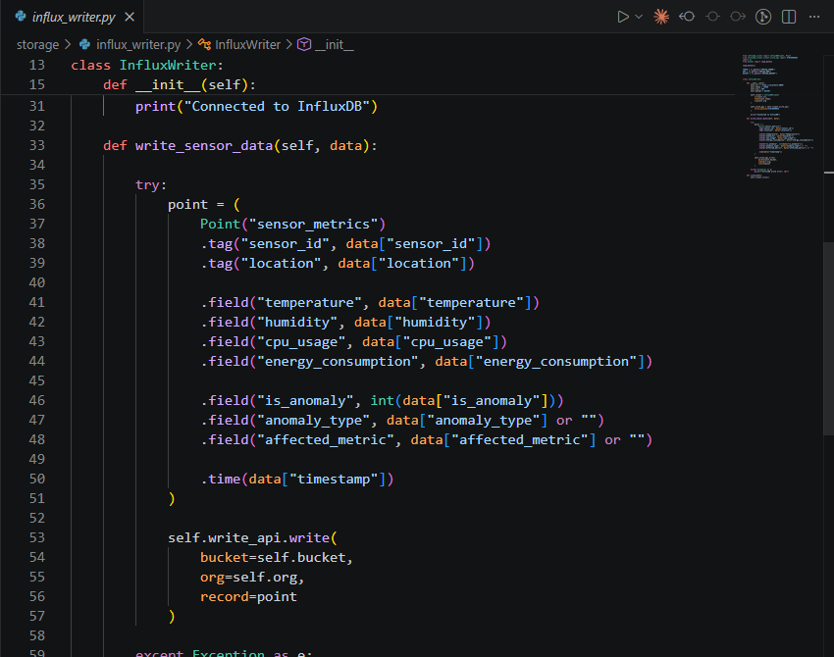
INFLUXDB IMPLEMENTATION
InfluxDB provides:
Optimised for time-series data
Fast writes
Efficient timestamp indexing
Time window queries
Notes:
InfluxDB serves as the primary storage layer.
Unlike traditional relational databases, it is specifically optimised for timestamped records and provides efficient handling of sequential sensor data.

Slide 15
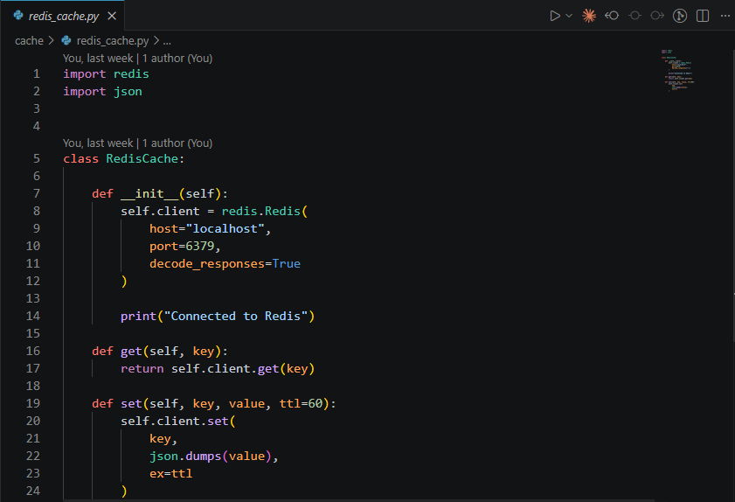
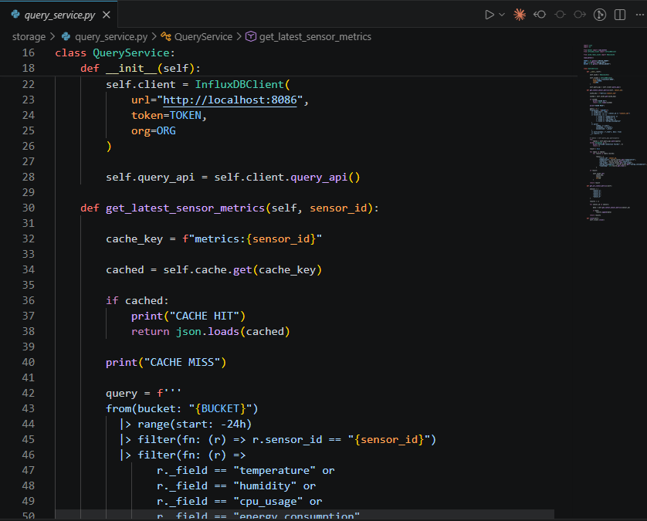
REDIS CACHING MECHANISM
REQUEST
REDIS
HIT
MISS
DATA
INFLUXDB
Notes:
The caching layer is central to this project.
When data is requested, Redis is checked first.
A cache hit returns data immediately.
A cache miss triggers an InfluxDB query and stores the result in Redis for future requests.
This reduces database load and improves response times.

Slide 16
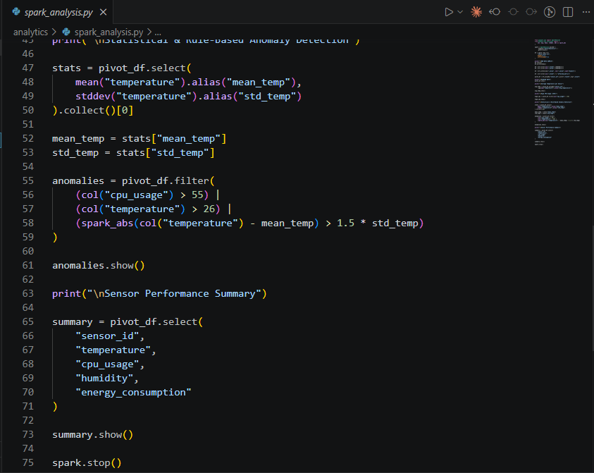
SPARK ANALYTICS PIPELINE
Average temperature
CPU usage
Energy consumption
Humidity
Notes:
Apache Spark was used for historical analytics.
Data is extracted from InfluxDB and transformed into Spark DataFrames.
Aggregations and analytical computations are then performed efficiently.

Slide 17
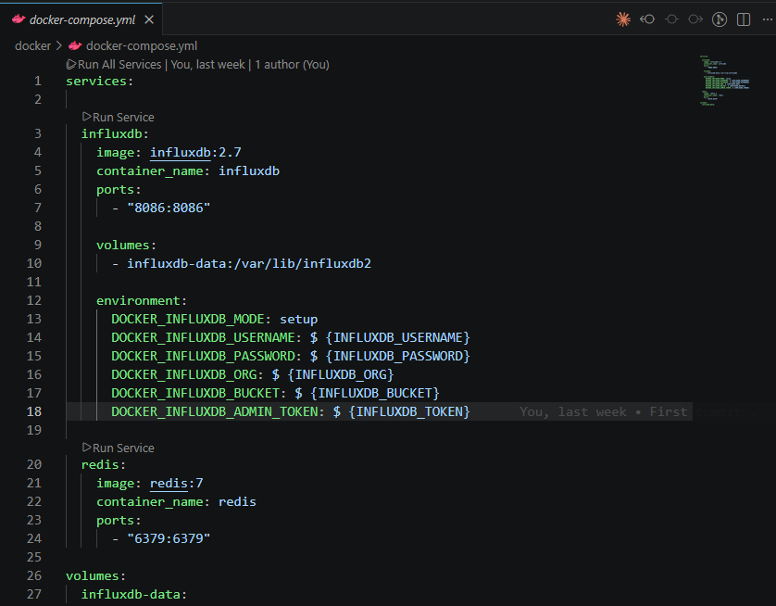
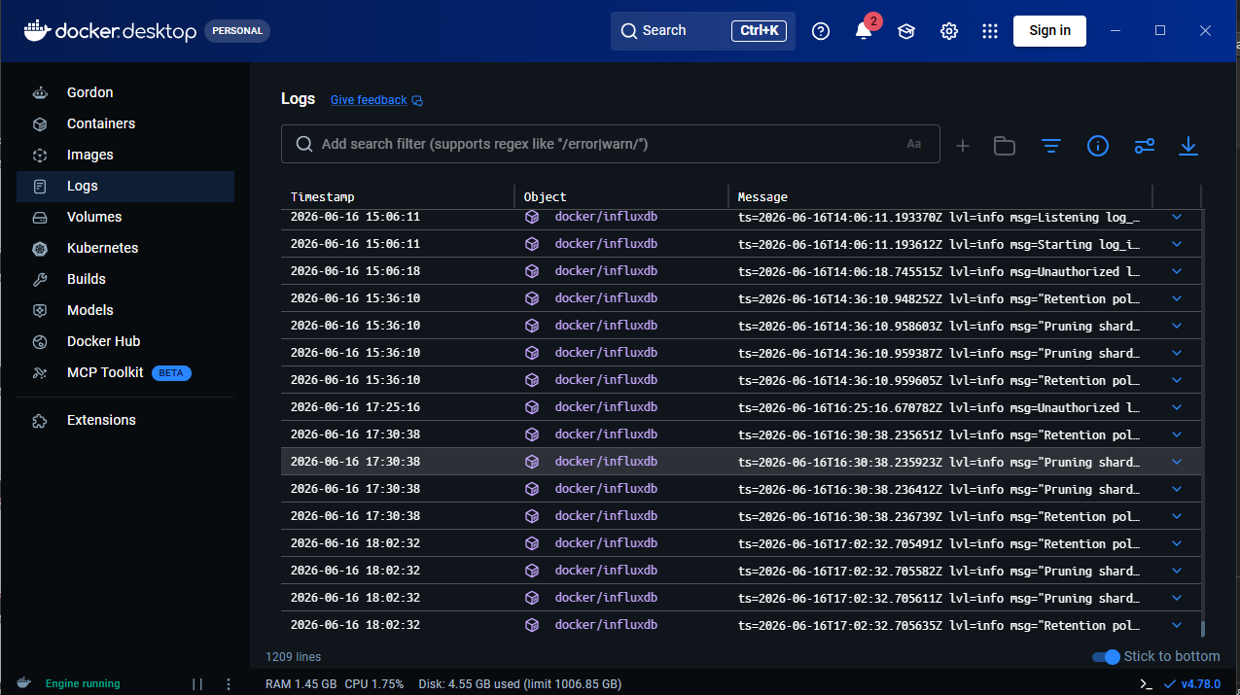
DOCKER DEPLOYMENT
Docker provides:
Reproducibility
Isolation
Portability
Simplified deployment
Notes:
Docker enabled consistent deployment across environments.
Each service operates within its own container, reducing dependency conflicts and simplifying setup.

Slide 18
SECTION 4
ANALYTICS, ANOMALY DETECTION & DASHBOARD

Slide 19
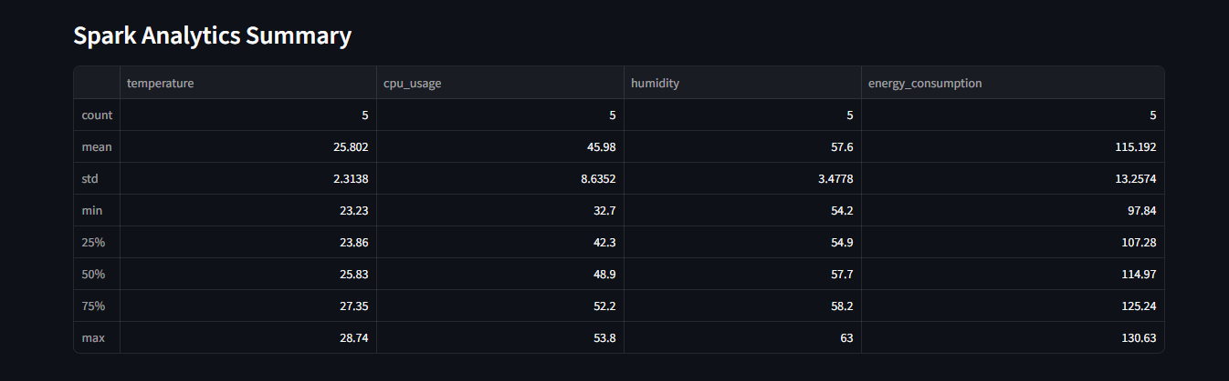
SPARK ANALYTICS RESULTS
Average temperatures
CPU trends
Energy patterns
Notes:
These results demonstrate the analytical capabilities of the architecture.
Spark successfully processed historical sensor data and generated aggregated insights.

Slide 20
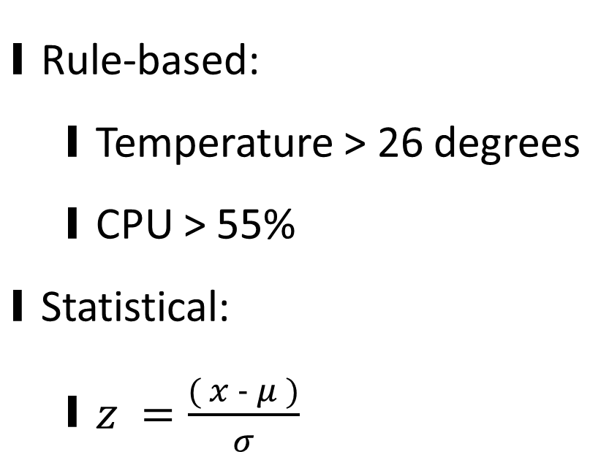
ANOMALY DETECTION
Rule-based:
Temperature > 26 degrees
CPU > 55%
Statistical:
$z =\frac{( x − μ )}{σ}$
Notes:
We implemented both rule-based and statistical anomaly detection.
The rule-based approach identifies obvious threshold violations.
The Z-score method identifies statistically unusual observations where x = the value being evaluated
μ = the mean
σ = the standard deviation
Combining both approaches improves detection coverage.

Slide 21
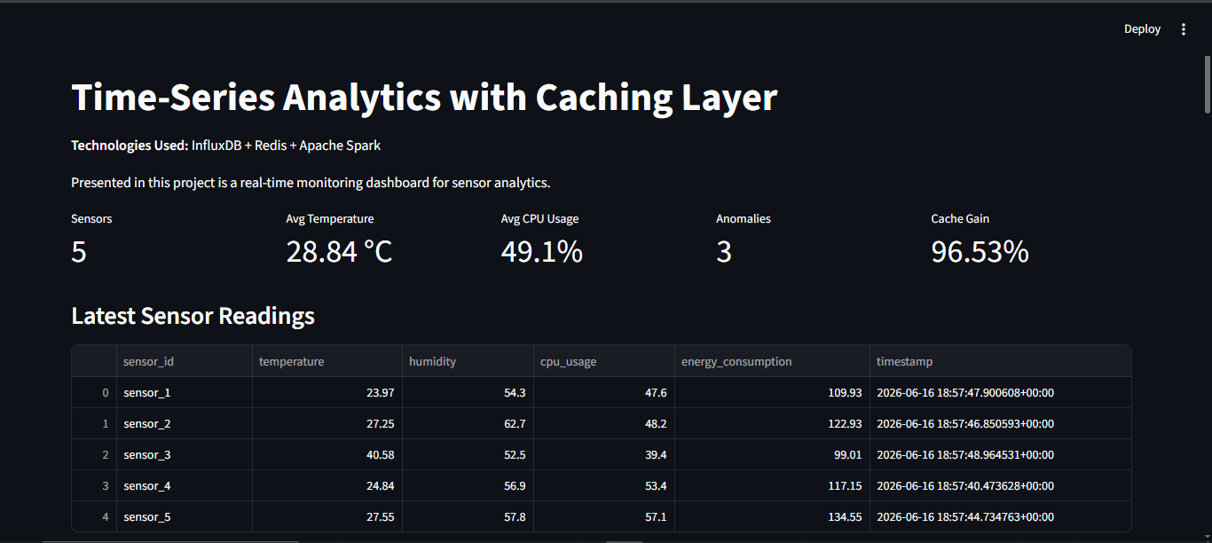
DASHBOARD OVERVIEW
Features:
Real-time updates
KPI cards
Health indicators
Visualisations
Notes:
The Streamlit dashboard serves as the presentation layer.
Users can monitor system performance and sensor behaviour in real time.

Slide 22
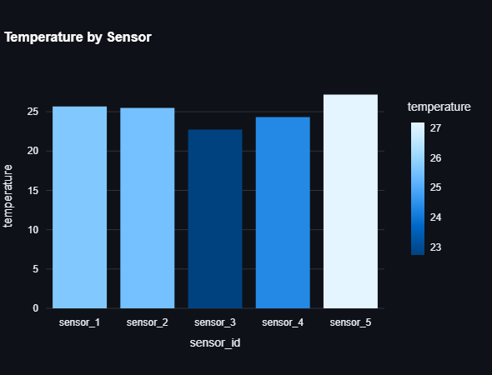
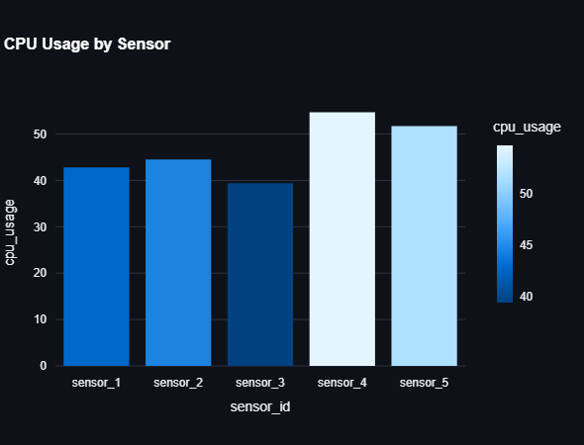
DASHBOARD VISUALISATIONS
Notes:
Plotly was used because it supports interactive exploration.

Slide 23
SECTION 5
EVALUATION & REFLECTION

Slide 24
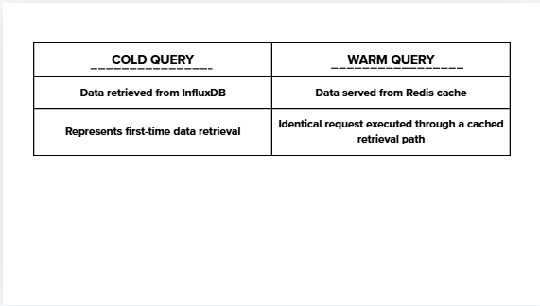
Performance Evaluation Methodology
Evaluation Setup
Same query
Same dataset
Measured using Python timer
Tested cold cache
Tested warm cache
Notes:
To evaluate the caching layer, we compared two scenarios.
The first accessed data directly from InfluxDB.
The second retrieved previously cached data from Redis.
This allowed us to quantify the impact of caching.

Slide 25
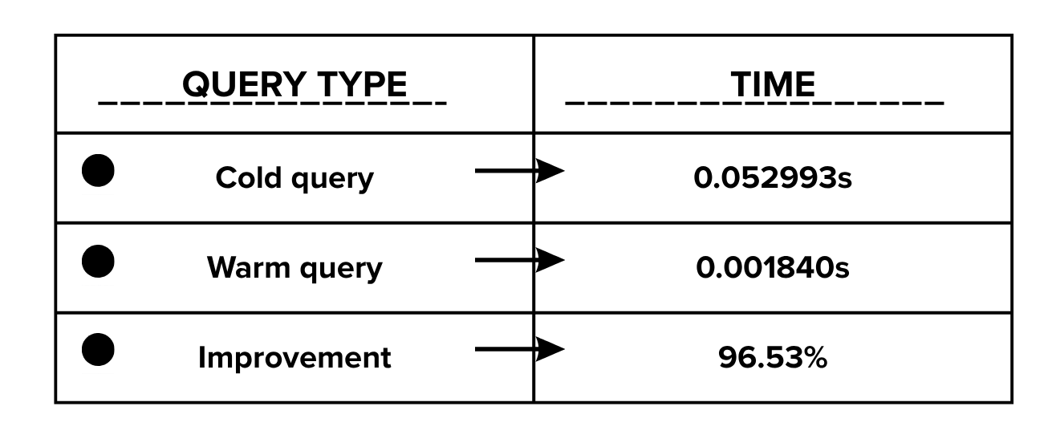
PeRFORMANCE RESULTS
Notes:
The results clearly demonstrate the effectiveness of caching.
Redis reduced query latency from approximately 53 milliseconds to under 2 milliseconds.
This represents a performance improvement of 96.53%.

Slide 26
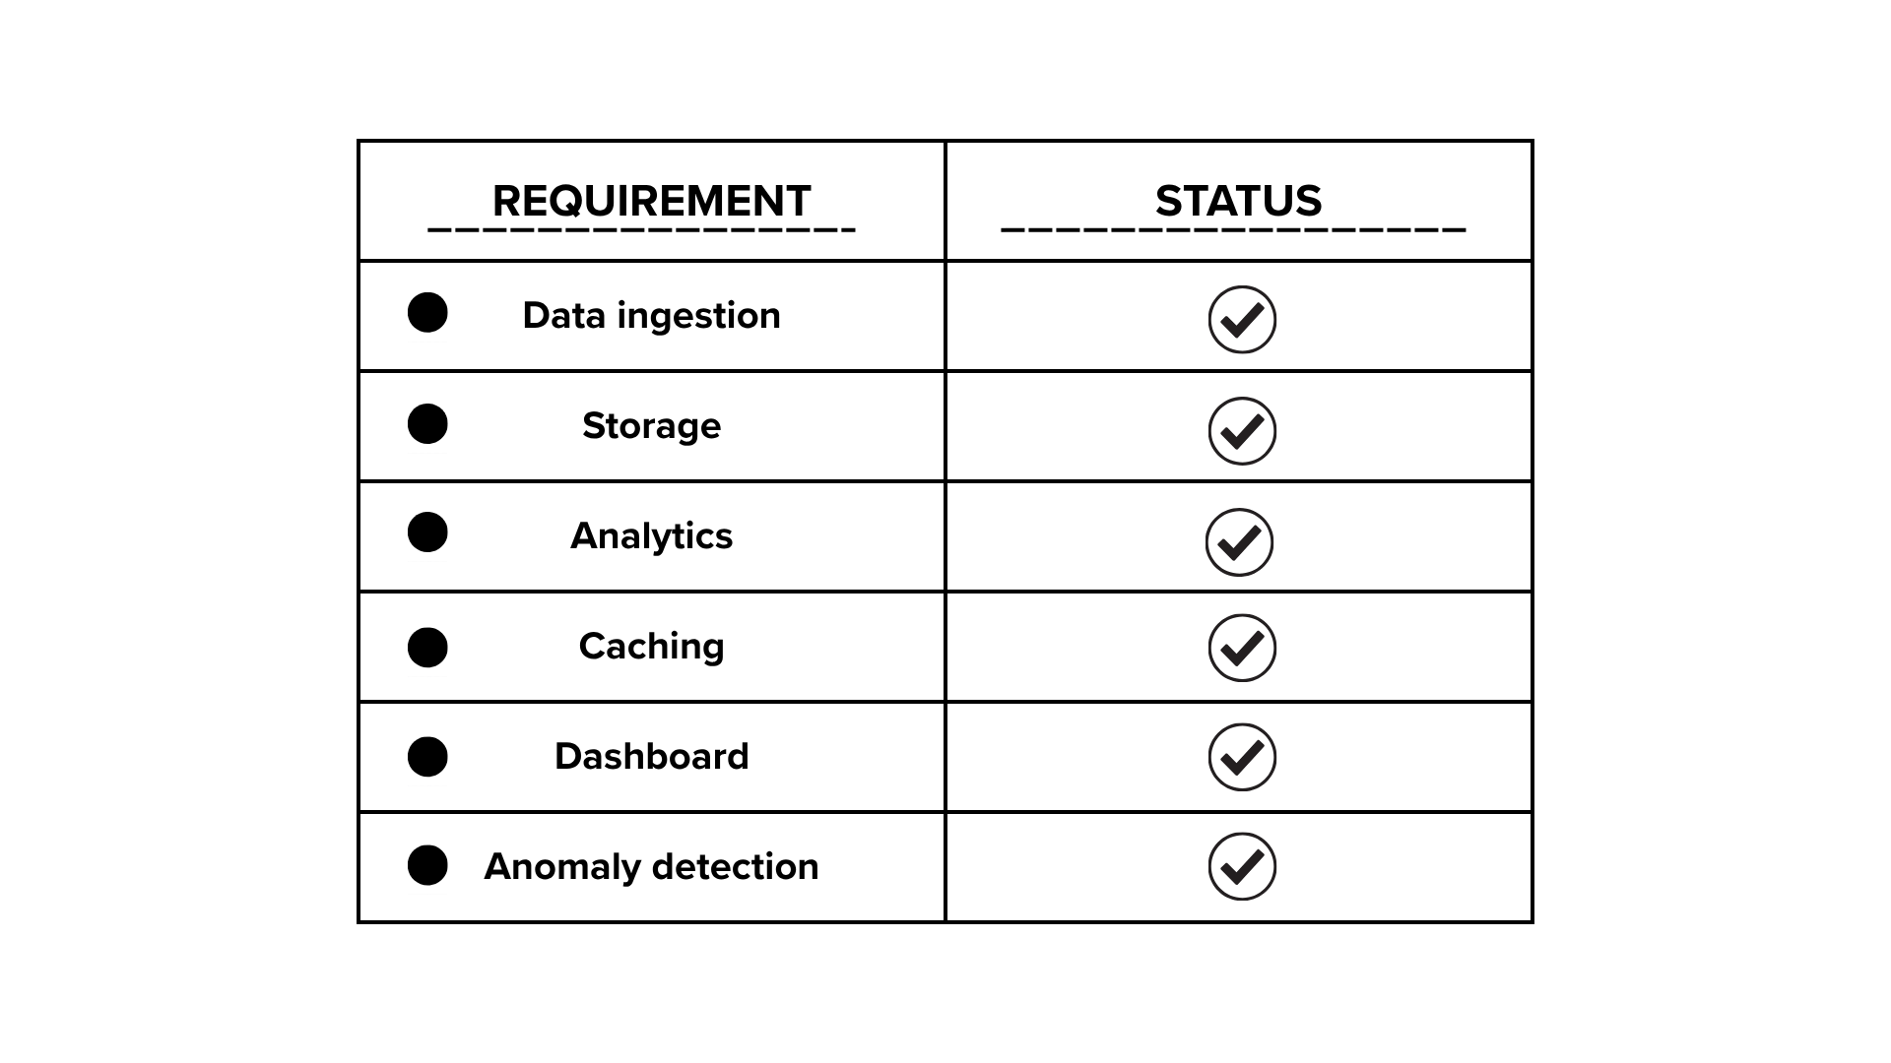
SYSTEM EVALUATION
Notes:
All primary project objectives were achieved.
The system successfully integrates ingestion, storage, analytics, caching, and visualization into a unified architecture.

Slide 27
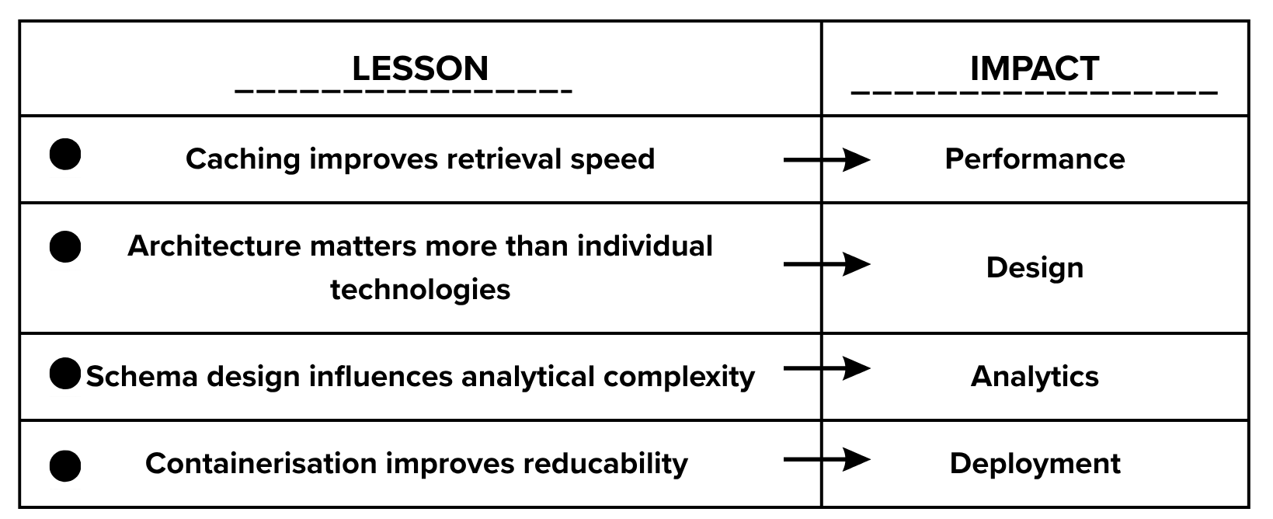
Challenges & lessons Learned

Slide 28
FUTURE ENHANCEMENTS
Machine learning anomaly detection
Grafana dashboards
Spark structured streamking
Kubernetes deployment
Cloud infrastructure
Notes:
Future work would focus on enhancing scalability and intelligence.
Mlearning could provide predictive anomaly detection.

Slide 29
COntributions
✓ End-to-end Big Data architecture
✓ Continuous time-series ingestion
✓ Redis caching integration
✓ Spark analytics
✓ Real-time dashboard
✓ 96.53% latency reduction
Notes:
In conclusion, this project successfully demonstrates how modern Big Data technologies can be integrated to support time-series analytics.
The architecture achieved all project objectives and demonstrated substantial performance gains through caching.
Most importantly, it provides a scalable foundation for future real-time analytics systems.

Slide 30
THANK YOU!
DANKE
Notes:
Thank you for your attention.
We would be happy to answer any questions.

